Slide 1

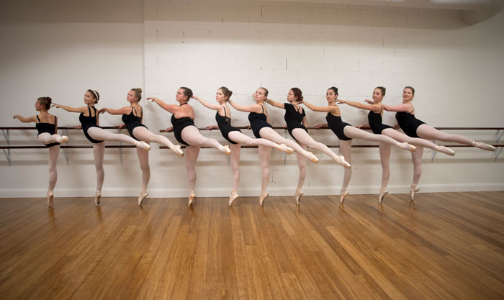
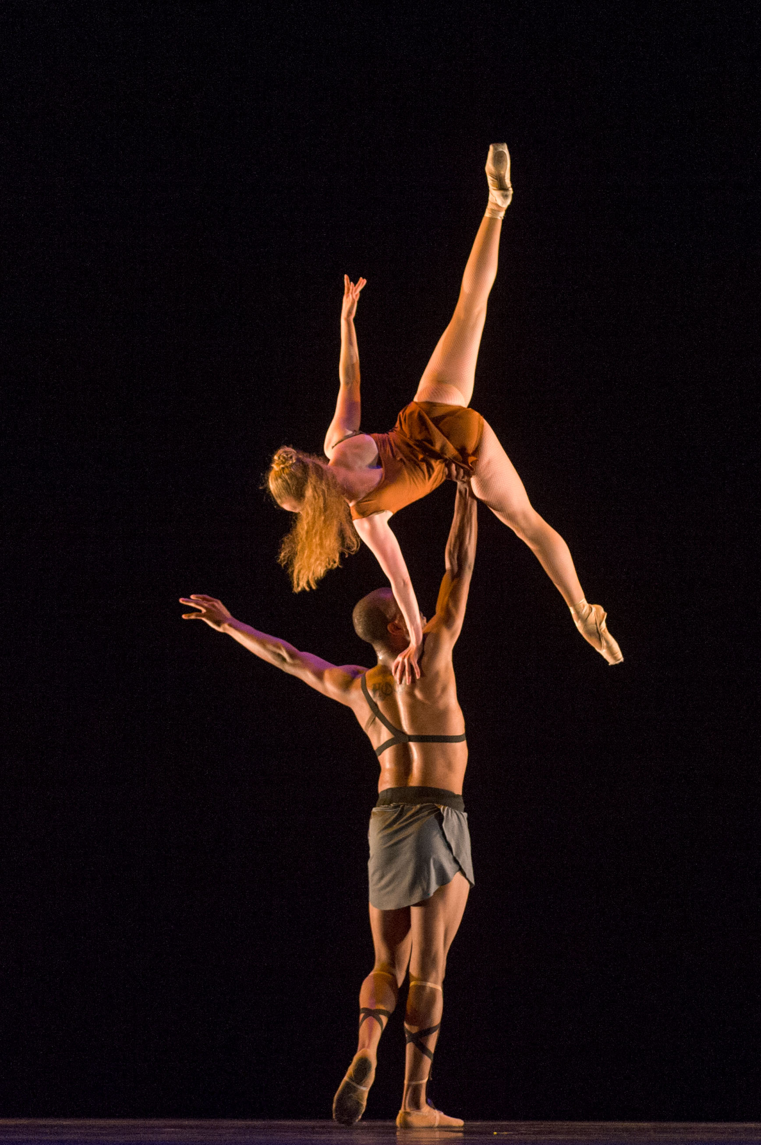
Exercise Testing as a Predictor of Performance Ability in High School Level Dancers
Joshua Wludyga & Riley Cooper
Exercise Science, Georgia Gwinnett College, Lawrenceville GA
Abstract
FMS SM L | FMS SM R | FMS ASLR L | FMS ASLR R | FMS DS | FMS HS L | FMS HS R | FMS TS | FMS IL L | FMS IL R | FMS ROT L | FMS ROT R | T-Test (1) | T-Test (2) | Vertical Jump (in) | VO2max (ml/kg/min) | Extensor Peak Torque (R) | Flexor Peak Torque (R) | Extensor Peak Torque (L) | Flexor Peak Torque (L)
3 | 3 | 3 | 3 | 2 | 2 | 2 | 3 | 2 | 3 | 2 | 2 | 14.12s | 13.69s | 17 | 35.2 | 83.6 | 36.9 | 67.5 | 36.7
2 | 2 | 3 | 3 | 2 | 2 | 3 | 3 | 3 | 3 | 2 | 2 | 17.44s | 15.25s | 20.5 | 34.05 | 124.5 | 58.1 | 86.2 | 48.9
3 | 2 | 3 | 3 | 2 | 3 | 2 | 3 | 3 | 3 | 2 | 2 | 15.13s | 13.75s | 17 | 37.56 | 65.3 | 33.2
3 | 3 | 3 | 3 | 3 | 3 | 3 | 1 | 3 | 3 | 2 | 2 | 13.63s | 12.77s | 20.5 | 43.7 | 83.4 | 42.1 | 91 | 45.6
3 | 3 | 3 | 3 | 2 | 3 | 2 | 3 | 3 | 3 | 2 | 2 | 14.2s | 13.22s | 18 | 28.88 | 59.9 | 34.3 | 70.5 | 31.2
2 | 2 | 3 | 3 | 3 | 3 | 3 | 2 | 3 | 3 | 3 | 3 | 14.21s | 13.77s | 18 | 39.09 | 97.3 | 54.5 | 95.7 | 48.3
Background and Application
Preliminary Results
PURPOSE: The aim of this study is to examine different components relating to the physical fitness level of elite high school aged dancers in order to ascertain whether there is a direct correlation between physical fitness and performance. The hypothesis is that study will show that the dancers with higher physical fitness are the best performers overall. METHODS: High School aged dancers participated in various exercise tests to measure power, strength, flexibility, agility. Tests included body composition, FMS, Biodex, T-Test, the Bruce Protocol, and Vertical Jump. Performance was measured through a standardized assessment tool to assign quantitative values to various components of a dance combination.
RESULTS: Results are preliminary. Highest scores for FMS testing were the Active Straight Leg Raise, and the lowest scores were for Trunk Rotation and Trunk Stability. This is indicative that upper body strength and stability can be improved. When compared to high school volleyball players, the dancers scored below normative T-Test scores, and within average vertical jump scores. The participants’ VO2max numbers were below average for ballet dancers. CONCLUSIONS: Research is still ongoing. Preliminary conclusions can be made that dancers tend to have stronger and more stable lower extremities, and less core strength and stability. Agility in the sagittal and frontal plane was below average, which may be due to unconventional agility demands in dance technique. The dancers appear to have adequate power and force production, according to vertical jump results. PRACTICAL APPLICATIONS: This study serves as an outline for future research on the topic of physical fitness correlations with performance. Studies such as these will be crucial to the future of dance. Much attention is being brought to professional level, adult dancers and the improvement of specification in conditioning for the purpose of improving performance, but more research needs to be done on high school aged dancers specifically.
Table 1 – Preliminary Results of Exercise Testing per Participant
To date, there has been little in the way of correlating dancer performance with physical fitness. This type of exercise involves high intensity intervals so there is large emphasis on balance, power output, and flexibility. Dancers are already prone to injuries. As reported in one study, 85% of participants had at least 1 dance related injury within a 12-month period (Twitchett, et al., 2009). Multiple factors of dancing are thought to contribute to the pervasiveness of injury within the dance community, including unsuitable flooring, insufficient warm-ups, difficult choreography, overwork, low aerobic fitness level, and poor shoes. It is important to identify areas of weakness and strength to see where training can be optimized. Previous testing on dancers has shown that by using the Functional Movement Screen (FMS), their lowest scoring movements before intervention were the deep squat and the trunk stability push-up; whereas their highest scoring were the shoulder mobility and active straight leg raise (Skotnicka, et al., 2017). Strength and conditioning programs can help to reduce the risk of injury due to gaps in training that naturally occur in dance technique. The purpose of this study is to observe the results of fitness testing and see if there is a connection between physical fitness and performance. This study seeks to improve dance-specific conditioning to prevent injury and improve performance.
P values calculated for 2-tailed paired t-test comparing AM and PM sway velocity means
Hypotheses
The aim of this study is to examine different components relating to the physical fitness level of high-school aged dancers in order to ascertain whether there is a direct correlation between physical fitness and performance. This study will show that the dancers with higher physical fitness are the best performers overall.
Methods
Subjects participated in exercise testing to measure power, strength, agility, flexibility, and performance.
Functional Movement System (FMS) testing was performed – a series of 7 movements. A score of 1 is given if the movement could not be completed and a score of 2 is given if the task is completed but lacked full range of motion. A score of 3 is provided if the participant was able to complete the task completely, without any compensation or pain.
The Functional Movement System consists of 7 movements:
Straight-leg Mobility (SM)
Deep Squat (DS)
Trunk Stability Push-Up (TS)
Rotary Stability (ROT)
In-line Lunge (IL)
Active Straight Leg Raise (ASLR)
Hurdle Step (HS)
A Vertec Vertical Jump was used to determine the amount of power generated by the lower extremities in the vertical plane. Reach Height (RH) was measured first, followed by Jump Height (JH). The difference between the two was taken to reveal the Vertical Jump (VJ) score.
Agility was assessed using the T-Test. The results were measured in seconds needed to complete the course and best of two trials was recorded.
An Isokinetic Dynamometer (Biodex) was used to measure concentric torque of the knee flexor and extensor muscles at an angular velocity of 60 deg/s.
Aerobic endurance was measured using the Bruce Protocol. VO2max was calculated based on the participant’s body composition and time taken to complete the protocol.
Performance was assessed by observing dancers performing a short combination. A video of this dance combination was scored using a form adapted from Dowse et al. (2017).
1
This Photo by Unknown Author is licensed under CC BY
Select References
Dowse, R.A., McGuigan, M.R., Harrison, C. (2017). Effects of a Resistance Training Intervention on Strength, Power, and Performance in Adolescent Dancers. The Journal of Strength and Conditioning Research. 34(12): 3446-3453. DOI: 10.1519/JSC.0000000000002288
Twitchett, E., Angioi, M., Koutedakis, Y., Wyon, M. (2010). The demands of a working day among female professional ballet dancers. Journal of Dance Medicine & Science: Official Publication of the International Association for Dance Medicine & Science, 14(4): 127-32.
Skotnicka M., Karpowicz, K., Bartkowiak, S., & Strzelczyk, R. (2017). The impact of the
corrective and stability exercises program on the quality of basic movement patterns
among dance students. Trends In Sport Sciences, 24(1), 31-38.
This Photo by Unknown Author is licensed under CC BY-NC

